Slide 1
Workshop on Arty A7 FPGA board using Verilog
DAY-2
Jayaraj V S
Assistant professor
Department of ECE
SBCE

Slide 2
Lets begin programming with Vivado MicroBlaze

Slide 3
What is the MicroBlaze Processor?
MicroBlaze is Xilinx’s soft processor core optimized for embedded applications on Xilinx devices.
The MicroBlaze processor is easy to use and delivers the flexibility to select the combination of peripherals, memory, and interfaces as needed.
The MicroBlaze processor is commonly used in one of three preset configurations as shown below:
Microcontroller: Suitable for running BareMetal code
Real-Time Processor: Deterministic real-time processing on an RTOS
Application Processor: Embedded Linux capable

Slide 4
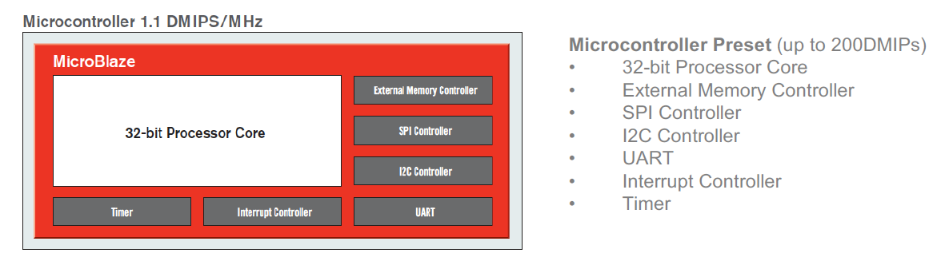
Processor Configuration Presets

Slide 5
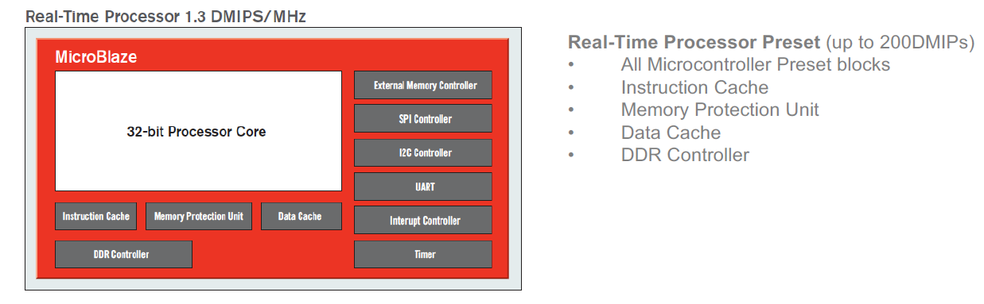
Processor Configuration Presets

Slide 6
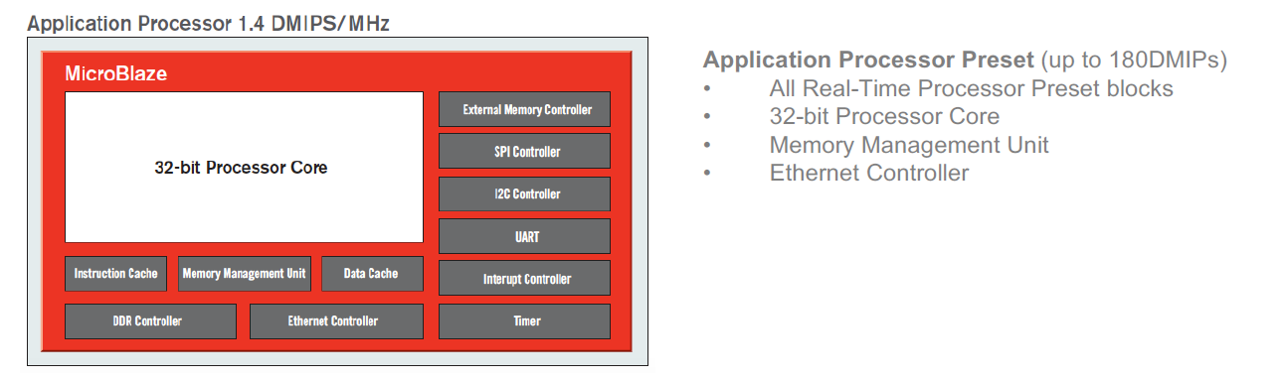
Processor Configuration Presets

Slide 7
Overview of the Hardware Architecture

Slide 8
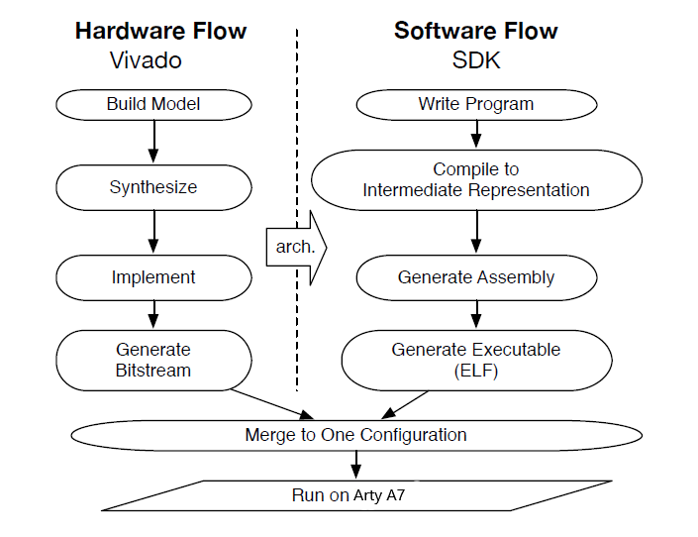
Overview of the Design Flow

